Slide 1
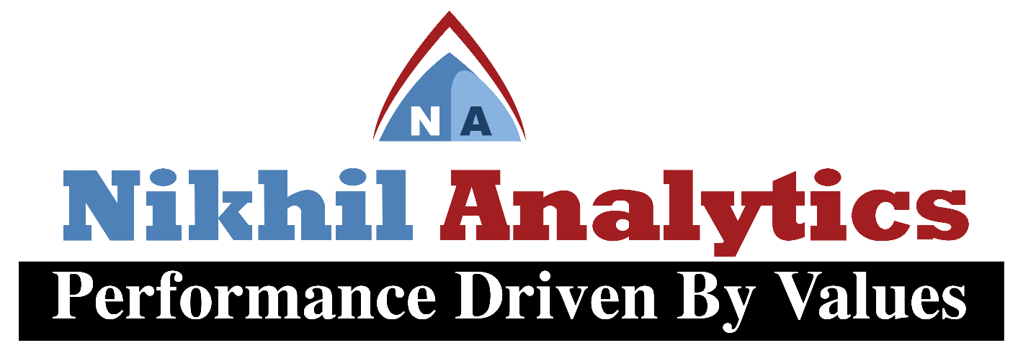
Session 1I
By
Alok Ranjan
Nikhil analytics

Slide 2

Agenda of Session 1I
Modules Introductions
Numpy module
Pandas module
Extraction

Slide 3

What are Modules?
Modules are files containing Python definitions and statements (ex. name.py)
A module’s definitions can be imported into other modules by using “import name”
The module’s name is available as a global variable value
To access a module’s functions, type “name.function()”

Slide 4
NumPy
NumPy is a Python C extension library for array-oriented computing
Efficient
In-memory
Contiguous (or Strided)
Homogeneous (but types can be algebraic)
NumPy is suited to many applications •
Image processing
Signal processing
Linear algebra
A plethora of others

Slide 5
NumPy
import numpy as np
In [1]: a = np.array([1,2,3])
In [2]: a.dtype
Out[2]: dtype('int64’)
In [3]: b = np.array([1,2,3,4.567])
In [4]: b.dtype
Out[4]: dtype('float64')
>>> a = np.array([[1, 2, 3], [4, 5, 6]], float)
>>> a
array([[ 1., 2., 3.], [ 4., 5., 6.]])
>>> a[0,0]
1.0
>>> a[0,1] 2.0

Slide 6
PANDAS : Data Frame
Pandas is a general purpose package to store multiple data of different types in spreadsheet style.
pd.DataFrame()
It can perform all various data analytics task such as
Sorting The Data
Group by
Adding New columns
Dropping columns
Transpose

Slide 7
Extraction
import pandas as pd
From Text
pd.read_table()
From CSV
pd.read_csv()
From Excel
pd.read_excel()

Slide 8
Practice and Assignment
Numpy package
Pandas Package
Data Extraction
Data Manipulation

